Slide 1
Solving Concurrency Issues with the Parallel Debugger and
Parallel Performance Analyzer
Notes:
KEY POINTS
Specify what the lab is about, what will be learned, and why we think this is an important topic.
***********************************************************
SCRIPT
***********************************************************
POTENTIAL QUESTIONS
Question #1
***********************************************************
NOTES
Note #1
***********************************************************

Slide 2
Introduction
Visual Studio 2010 includes support for writing parallel applications
PLINQ and Parallel Extensions to the .Net Framework
The Concurrency Runtime
Other bundled tools make writing parallel code an easier task
This does not mean writing parallel code is easy!
This lab will show you some of the common pitfalls (and how to identify them) when working with parallel code.

Slide 3
Exercise-1 Background
Stepping is one of the most useful debugging techniques
You are able to examine the state of the program, variables, and related data before and after executing a particular line of code
Various stepping operations can assist you while debugging:
Step Into
Step Over

Slide 4
Debugging Basics
The main debugging windows that in Visual Studio are the Threads window, the Call Stack window, and the variable windows
These windows work fine for simple applications, but can be quite difficult to work with when debugging in parallel
You need to examine the call stack of each thread
If you have multiple threads, creating the mental picture is truly challenging

Slide 5
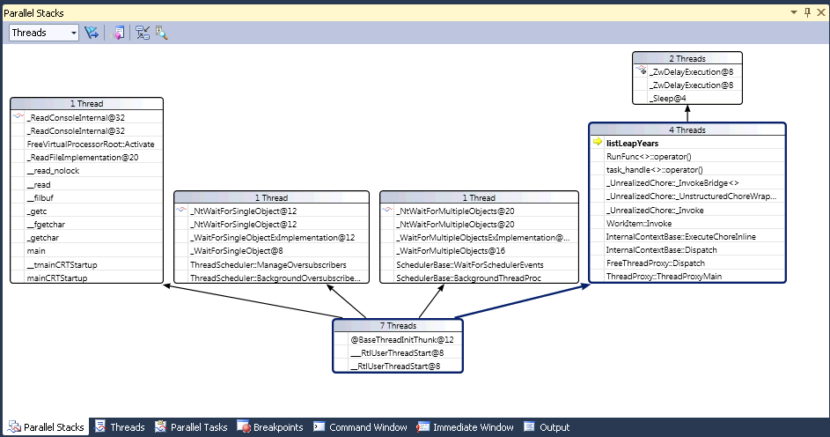
Parallel Stacks
Visual Studio 2010 includes a Parallel Tasks / Threads window
The threads view displays call stack information for ALL threads in your application.
This simplifies the process of examining your thread’s execution

Slide 6

Parallel Tasks
Tasks represent asynchronous operations that can run concurrently
The new tasks window displays the list of running tasks of an application
The Parallel Tasks window, exposes features similar to the Threads window, indicating:
The current task (the top-most task running on the current thread)
The ability to switch the current task, flagging of tasks, and freezing and thawing threads.

Slide 7
Leap Years
A little background for the exercise.
Every year that is evenly divisible by 4, is a leap year
For example, 1988, 1992, and 1996 are leap years
The Gregorian calendar also stipulates that a year that is evenly divisible by 100
If it is also evenly divisible by 400

Slide 8
Leap year Implementation
if(year % 4 == 0){
if (year % 100 != 0){
isLeap = true;
}
}
if(year % 400 == 0){
isLeap = true;
}

Slide 9

Exercise-1
Single Stepping with the Parallel Debugger
Notes:
KEY POINTS
***********************************************************
SCRIPT
***********************************************************
POTENTIAL QUESTIONS
Q: A:
***********************************************************
NOTES
***********************************************************

Slide 10
Exercise-1 Conclusion
Parallel Stacks and Parallel Tasks windows can help you visualize your concurrent application in a complete holistic picture
‘Pin the Variable’ feature in VS2010 can ease the debugging experience
Use conditional breakpoints to search for failing variable values and conditions

Slide 11
Exercise-2 Background
Correct resource usage is essential for the overall working of a multithreaded system
Synchronization is required to maintain data consistency when working with parallel programs
When resources can be accessed concurrently, they can be used inconsistently.
To prevent this, you must control the access using synchronization techniques

Slide 12
Critical Section
Code segments that access shared resources that must not be concurrently accessed by more than one thread of execution are critical sections
A critical section is typically used when a multithreaded program must update multiple-related-variables
They help synchronize the access to shared resources to avoid data race bugs

Slide 13
Semaphores
Semaphores are one way to synchronize access to shared resources
A thread must obtain a semaphore, to enter a critical section and releases the semaphore when exiting the section
Other threads are prevented from entering the critical section at the same time

Slide 14
Locks
Locks are synchronization mechanisms for enforcing limits on access to a resource in an environment where there are many threads of execution.
Most locking designs block the execution of the thread requesting the lock, until it is allowed to access the locked resource
Proper support for locks in a multiprocessor environment can require quite complex hardware and/or software support, with substantial synchronization issues.

Slide 15
Deadlocks
Deadlocks occur when two tasks are waiting for locks, each holding a lock that the other is waiting for.
Unless something is done, the two tasks will wait forever
A deadlock is a common problem in multiprocessing where many processes share a specific type of mutually exclusive resource (known as a software lock or soft lock).

Slide 16
Lock Control Example
if (global_lock_var == 0) {
global_lock_var = myPID;
}
More than one task could be testing this condition simultaneously

Slide 17
Deadlock Conditions
There are four general properties that must hold to produce a deadlock:
Mutual Exclusion
Hold and wait condition
No preemption condition
A Circular Wait Condition

Slide 18
Exercise-2
Visualizing Deadlocks
Notes:
KEY POINTS
***********************************************************
SCRIPT
***********************************************************
POTENTIAL QUESTIONS
Q: A:
***********************************************************
NOTES
***********************************************************

Slide 19
Exercise-2 Conclusions
The parallel stacks window can assist you identifying functions that are involved in a deadlock
It also provides info on the lines of code that were executed prior to the deadlock condition
VS2010’s debugging tools lets you visualize variables while debugging concurrent tasks
This makes parallel debugging a less complicated task

Slide 20
Exercise-3 Background
Let’s go over a brief overview of
Lock overhead
Locks granularity
Lock contention
Mutual exclusion

Slide 21
Locks disadvantages
Error Prone
Granularity balance
Scalability issues
Blocking
Unnecessary Overhead
Priority Inversion
Hard debugging
Lock convoying

Slide 22
Lock Convoys
A Lock Convoy takes place when threads repeatedly compete for a common resource or a shared critical section.
Lock convoys usually don’t affect the correctness of the multithreaded application, but they affect its performance.
The usual cause of a lock convoy is the improper use of concurrency control primitives, such as critical sections, to control access to commonly used resources.

Slide 23
Concurrency Visualizer
The Parallel Performance Analysis (PPA) Concurrency Visualization views make it possible for us to see how a multi-threaded application interacts with resources
The Concurrency Visualizer relies on Event Tracing for Windows (ETW) functionality that is found in Windows Vista and later versions.
The Concurrency Visualizer can be used to locate performance bottlenecks, CPU underutilization, thread contention, etc.

Slide 24
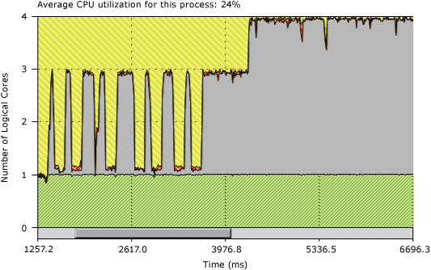
Lock Contention under the Concurrency Visualizer
A parallel application may seem to execute serially even though it’s running on many cores
Performance can be equal (or worse) than the serial version

Slide 25
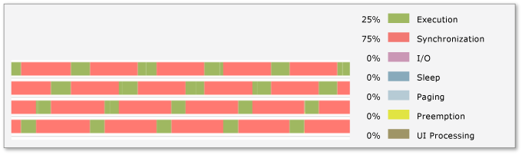
Lock Convoys under Concurrency Visualizer
Lock convoys occur when the application acquires locks in a first-come first-served order and the arrival rate at the lock is higher than the acquisition rate
The combination of these two conditions causes requests for the lock to start backing up
Lock convoys cause parallel applications to execute as if it was serial

Slide 26
Commands to protect critical sections
EnterCriticalSection
LeaveCriticalSection
WaitForSingleObject
ReleaseMutex

Slide 27
Exercise-3
Lock Convoys
Notes:
KEY POINTS
***********************************************************
SCRIPT
***********************************************************
POTENTIAL QUESTIONS
Q: A:
***********************************************************
NOTES
***********************************************************

Slide 28
Exercise-3 Conclusion
Lock convoys negatively affect the performance of parallel applications
The threads view of the PPA allows us to see which threads are blocking other threads
By freezing the application and inspecting what is happening at the thread level, you can easily identify lock convoys

Slide 29
Exercise-4 Background
Performance patterns can help you identify poor parallel performance in your applications
Lock Convoys
Uneven Distribution
Oversubsription
The following tutorials have been published to assist you with parallel patterns on the .Net Framework 4.0:
http://bit.ly/adEYkZ

Slide 30
Oversubscription
Poor performance can result when the number of active threads in a process is greater than the number of available logical cores on the host machine
This problem is commonly referred to as oversubscription
Basically, there are more threads than resources trying to compete to run.

Slide 31
Context switches
Context switches have a nonzero cost and they are especially costly when the cross occurs between cores
A context switch is the process of storing and restoring the state of a CPU in order to be able to resume execution from the same point after a time
This process takes time, and if you have many context switches in your application, your performance will be affected

Slide 32
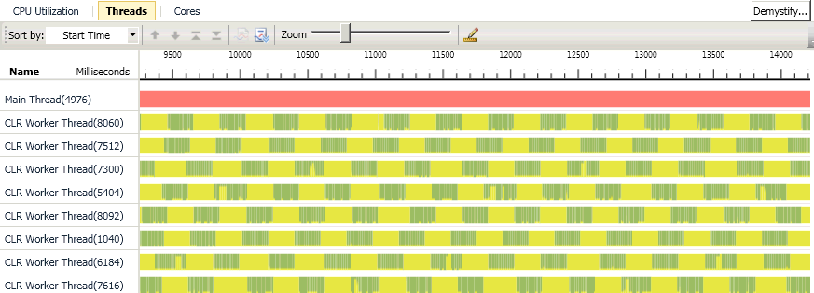
Oversubscription under Threads View
The threads view can shows us that there is a significant amount of additional preemption caused by these extra threads introduction

Slide 33
Concurrency Runtime
The Concurrency Runtime is a concurrent programming framework for C++
Its Parallel Patterns Library (PPL) provides general-purpose containers and algorithms for performing fine-grained parallelism
It enables task parallelism by providing task objects that distribute multiple independent operations across computing resources

Slide 34
Task Parallel Library
The Task Parallel Library (TPL) is a set of APIs in the System.Threading and System.Threading.Tasks namespaces
The TPL scales the degree of concurrency dynamically to efficiently use all the processors that are available
By using TPL, you can maximize the performance of your code while focusing on the work that your program is designed to accomplish

Slide 35
PLINQ
Parallel LINQ is a concurrent query execution engine for LINQ
It is use to parallelize the execution of queries on objects (LINQ to Objects) and XML data (LINQ to XML)
Any computation on objects implemented as queries can be parallelized by PLINQ

Slide 36
Exercise-4
Oversubscription
Notes:
KEY POINTS
***********************************************************
SCRIPT
***********************************************************
POTENTIAL QUESTIONS
Q: A:
***********************************************************
NOTES
***********************************************************

Slide 37
Exercise-4 Conclusion
Oversubscription is one of the many possible poor performance patterns that one must keep in mind when writing multithreaded applications
A good CPU Utilization != not necessarily a good sign when running parallel applications
You need to analyze the code with the PPA to identify potential issues that affect your application’s performance

Slide 38
Exercise-5 Background
The Parallel Patterns Library (PPL) includes several containers and objects that provide thread-safe access to their elements.
Concurrency::concurrent_vector
Concurrency::combinable
The combinable class lets you perform computations in parallel, and then combine those computations into a final result.

Slide 39
Exercise-5
Increasing Efficiency with Parallel Contrainers
Notes:
KEY POINTS
***********************************************************
SCRIPT
***********************************************************
POTENTIAL QUESTIONS
Q: A:
***********************************************************
NOTES
***********************************************************

Slide 40
Exercise-5 Conclusion
When you are dealing with shared data with multiple threads, you need to carefully plan your strategy in order to avoid synchronization problems
The combinable<T> object is a very simple but powerful construct that can help eliminate shared state in parallel algorithms that would otherwise limit scalability

